Slide 1
Proximity Measures for continuous attributes
Prof.Aruna Malapati

Slide 2
Learning Objectives
Define and compute proximity measures between objects when the attributes are of continuous type

Slide 3
Properties of distance measures
Distance d (p, q) between two points p and q is a dissimilarity measure if it satisfies:
1. Positive definiteness:
d (p, q) ≥ 0 for all p and q and
d (p, q) = 0 only if p = q.
2. Symmetry: d (p, q) = d (q, p) for all p and q.
3. Triangle Inequality:
d (p, r) ≤ d (p, q) + d (q, r) for all points p, q, and r.
Notes:
Examples:
Euclidean distance
Minkowski distance
Mahalanobis distance

Slide 4
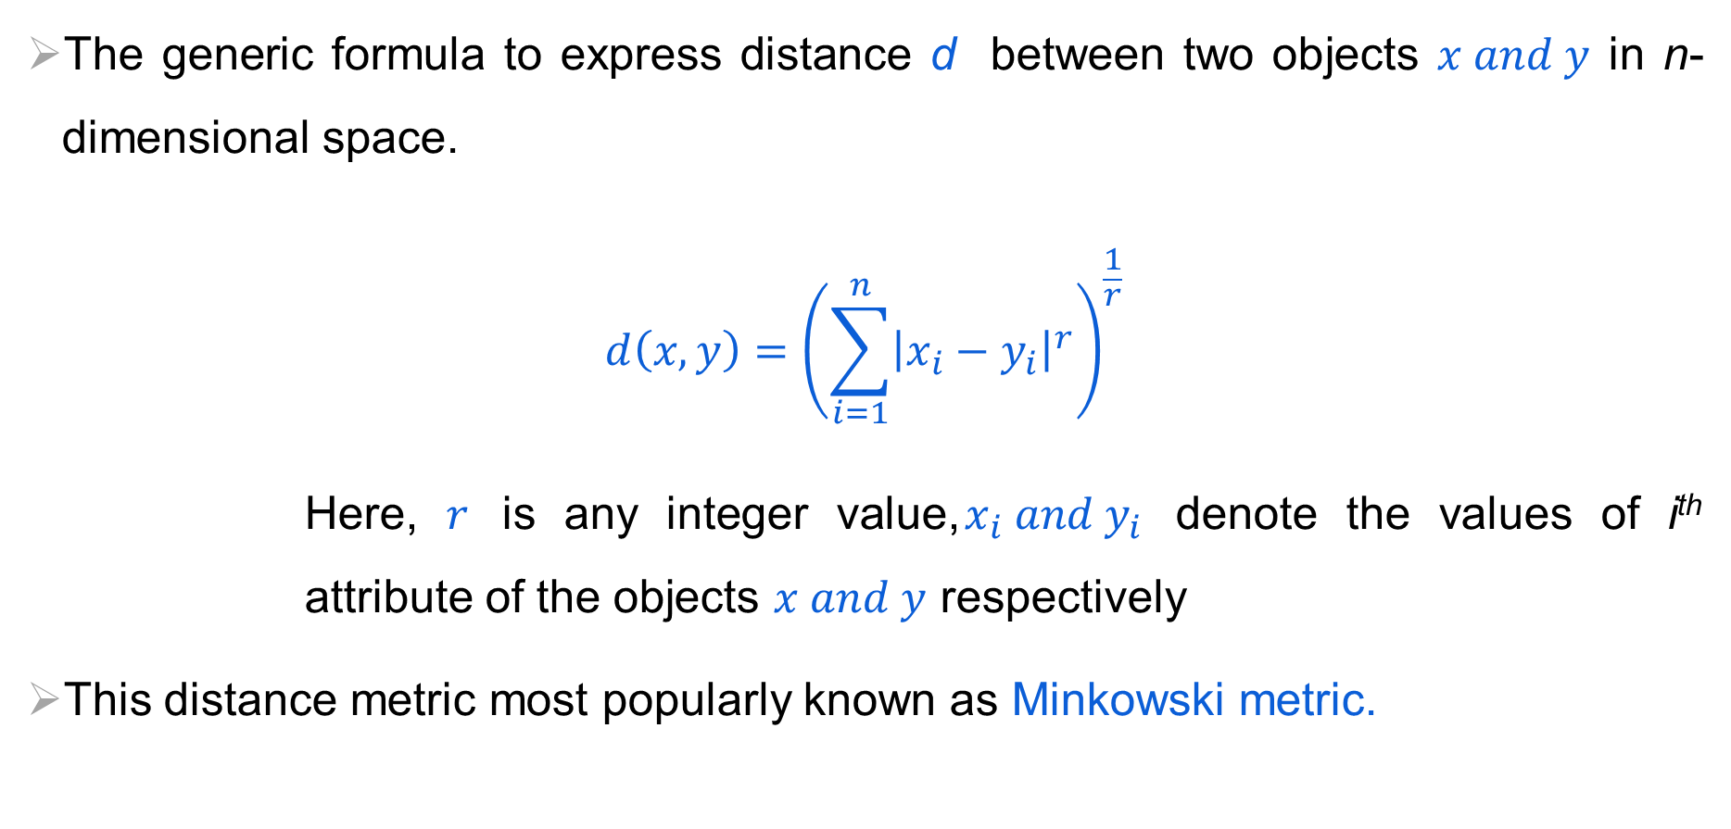
Proximity Measure with Interval Scale
The generic formula to express distance d between two objects $x and y$ in n-dimensional space.
$$d\left(x,y\right)={\left(\sum_{i=1}^{n}{{\left|x_{i}−y_{i}\right|}^{r}}\right)}^{\frac{1}{r}}$$
Here, $r$ is any integer value,$x_{i} and y_{i}$ denote the values of i^{th} attribute of the objects $x and y$ respectively
This distance metric most popularly known as Minkowski metric.
Notes:
Suppose, $x_{i} and y_{i}$ denote the values of i^{th} attribute of the objects $x and y$ respectively.

Slide 5
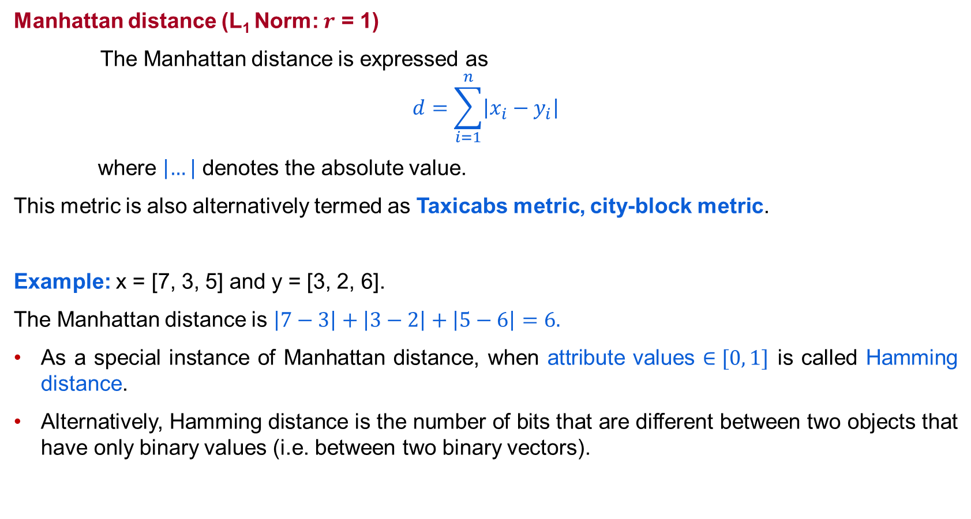
Proximity Measure with Interval Scale
Manhattan distance (L₁ Norm: $r$ = 1)
The Manhattan distance is expressed as
$$d=\sum_{i=1}^{n}{\left|x_{i}−y_{i}\right|}$$
where $\left|…\right|$ denotes the absolute value.
This metric is also alternatively termed as Taxicabs metric, city-block metric.
Example: x = [7, 3, 5] and y = [3, 2, 6].
The Manhattan distance is $\left|7−3\right|+\left|3−2\right|+\left|5−6\right|=6.$
As a special instance of Manhattan distance, when attribute values $∈[0, 1]$ is called Hamming distance.
Alternatively, Hamming distance is the number of bits that are different between two objects that have only binary values (i.e. between two binary vectors).
Notes:
Depending on the value of $r$, the distance measure is renamed accordingly.

Slide 6
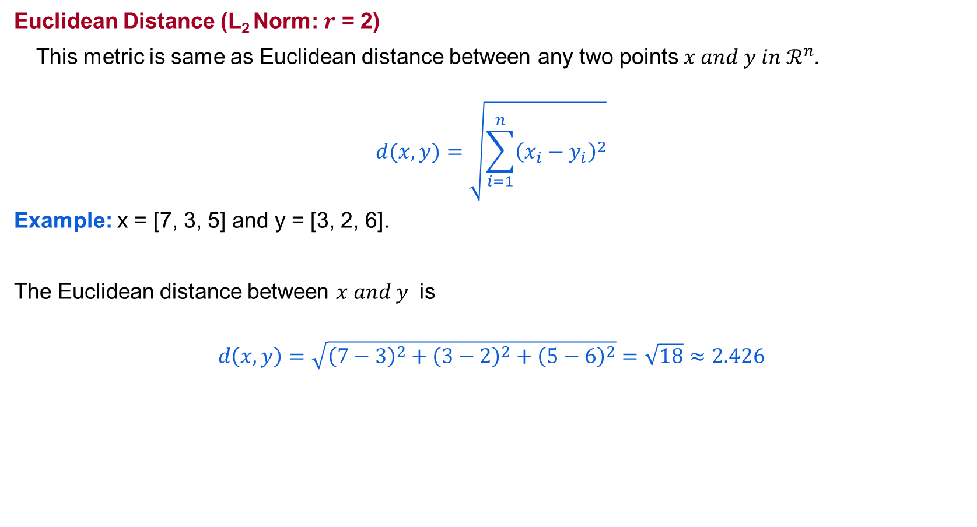
Proximity Measure with Interval Scale
Euclidean Distance (L₂ Norm: $r$ = 2)
This metric is same as Euclidean distance between any two points $x and y in ℛ^{n}$.
$$d(x,y)=\sqrt{\sum_{i=1}^{n}{{\left(x_{i}−y_{i}\right)}^{2}}}$$
Example: x = [7, 3, 5] and y = [3, 2, 6].
The Euclidean distance between $x and y$ is
$$d\left(x,y\right)=\sqrt{{\left(7−3\right)}^{2}+{\left(3−2\right)}^{2}+{\left(5−6\right)}^{2}}=\sqrt{18}≈2.426$$

Slide 7
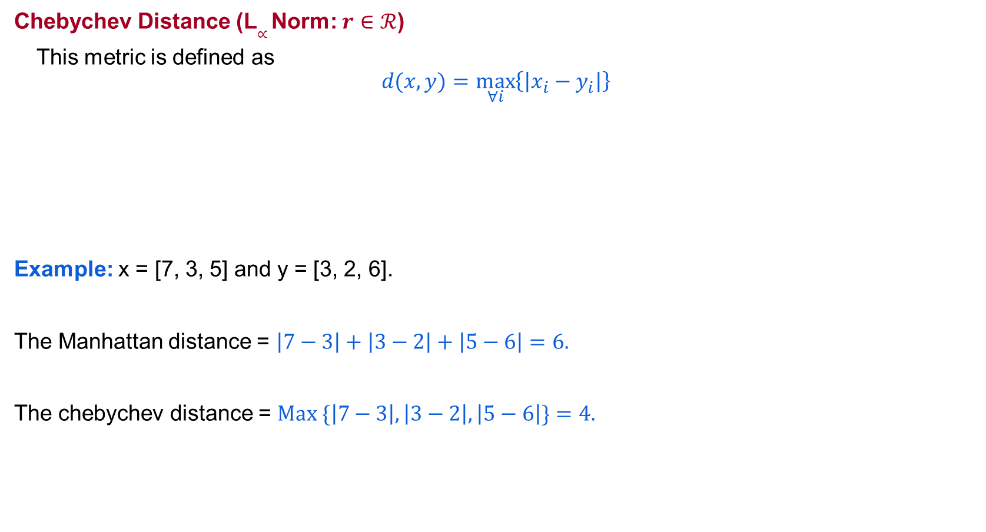
Proximity Measure with Interval Scale
Chebychev Distance (L$∝$ Norm: $r$ $∈ℛ$)
This metric is defined as
$$d(x,y)=\max_{∀i}\left\{\left|x_{i}−y_{i}\right|\right\}$$
Example: x = [7, 3, 5] and y = [3, 2, 6].
The Manhattan distance = $\left|7−3\right|+\left|3−2\right|+\left|5−6\right|=6.$
The chebychev distance = $Max \{\left|7−3\right|,\left|3−2\right|,\left|5−6\right|\}=4.$

Slide 8
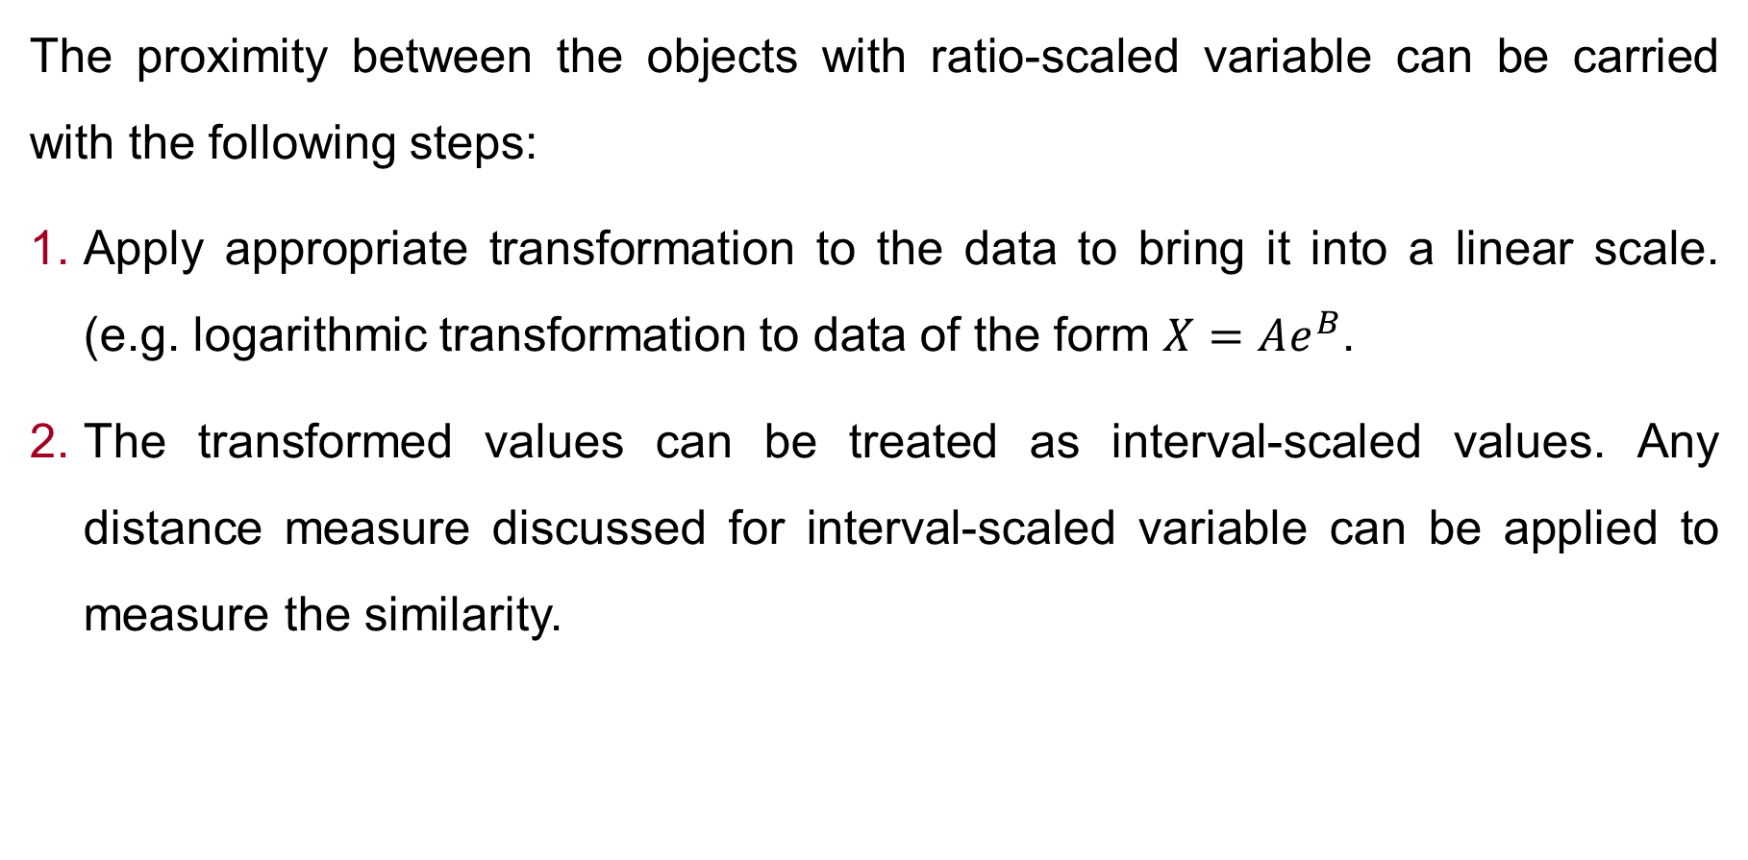
Proximity Measure for Ratio scale
The proximity between the objects with ratio-scaled variable can be carried with the following steps:
Apply appropriate transformation to the data to bring it into a linear scale. (e.g. logarithmic transformation to data of the form $X=Ae^{B}$.
The transformed values can be treated as interval-scaled values. Any distance measure discussed for interval-scaled variable can be applied to measure the similarity.

Slide 9
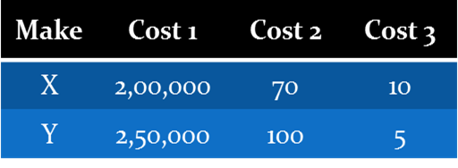
Proximity Measure for Ratio scale
Normalization:
A major problem when using the similarity (or dissimilarity) measures (such as Euclidean distance) is that the large values frequently swamp the small ones.
For example, consider the following data.
Here, the contribution of Cost 2 and Cost 3 is insignificant compared to Cost 1 so far the Euclidean distance is concerned.
This problem can be avoided if we consider the normalized values of all numerical attributes.

Slide 10
Proximity Measure for Mixed Attributes
The previous metrics on similarity measures assume that all the attributes were of the same type. Thus, a general approach is needed when the attributes are of different types.
One straightforward approach is to compute the similarity between each attribute separately and then combine these attribute using a method that results in a similarity between 0 and 1.
Typically, the overall similarity is defined as the average of all the individual attribute similarities.

Slide 11
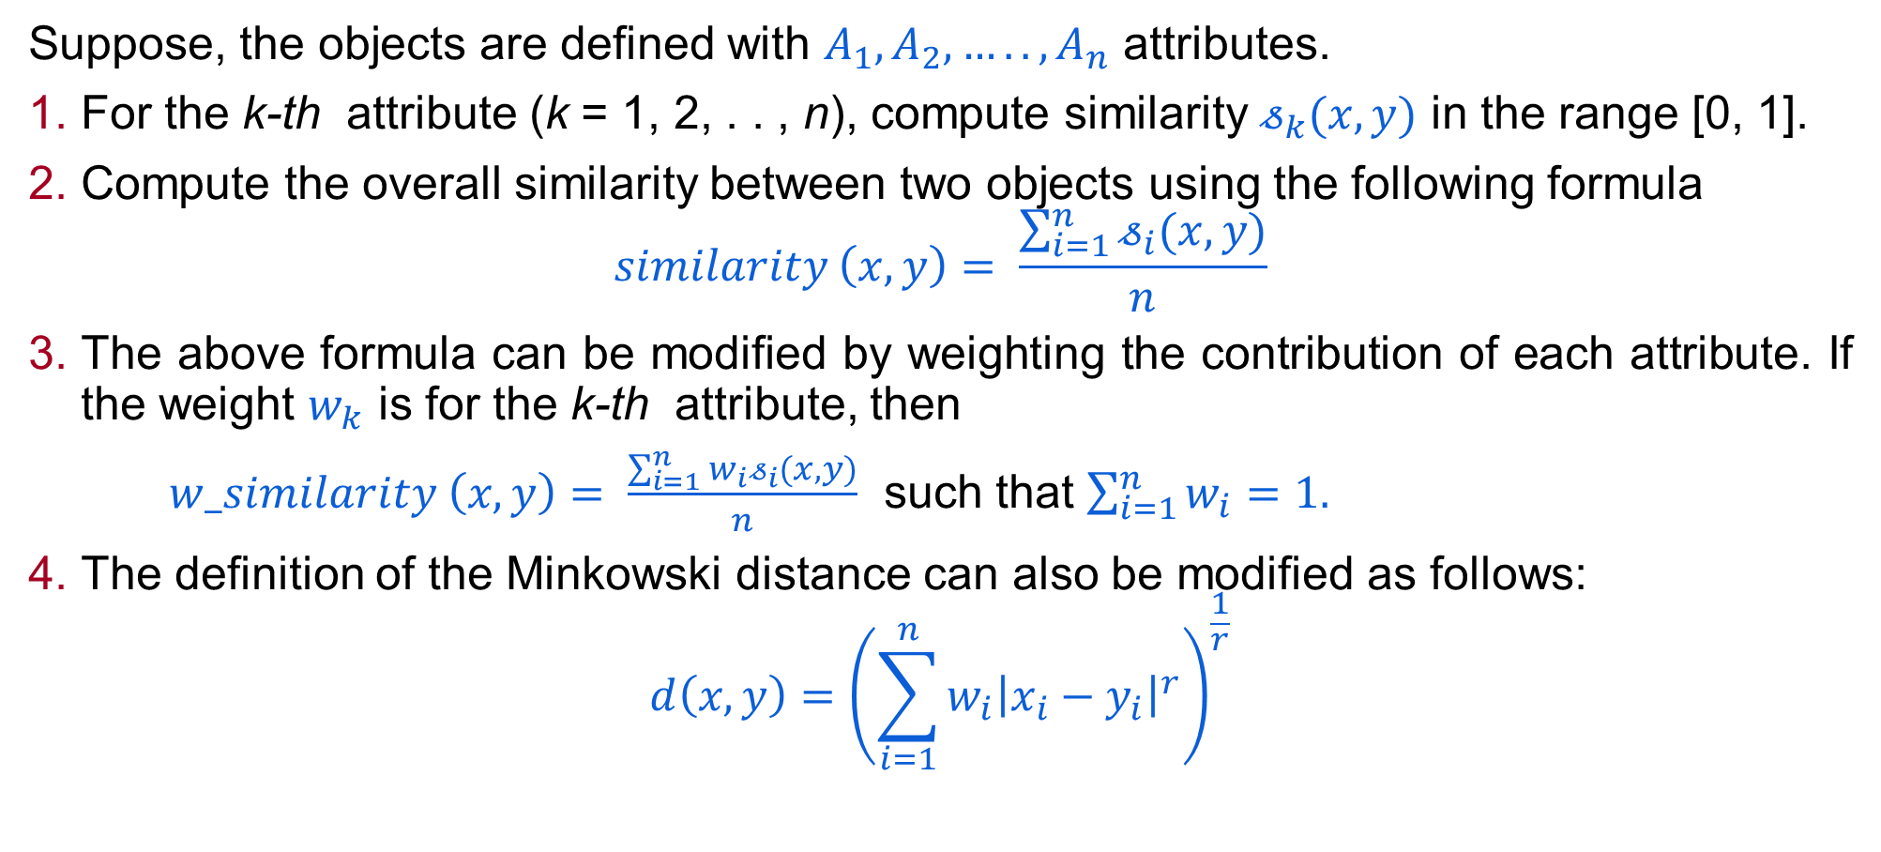
Proximity Measure with Vector Objects
Suppose, the objects are defined with $A_{1},A_{2},…..,A_{n}$ attributes.
For the k-th attribute (k = 1, 2, . . , n), compute similarity $𝓈_{k}(x,y)$ in the range [0, 1].
Compute the overall similarity between two objects using the following formula
$$similarity \left(x,y\right)= \frac{\sum_{i=1}^{n}{𝓈_{i}(x,y)}}{n}$$
The above formula can be modified by weighting the contribution of each attribute. If the weight $w_{k}$ is for the k-th attribute, then
$w_similarity \left(x,y\right)= \frac{\sum_{i=1}^{n}{{w_{i}𝓈}_{i}(x,y)}}{n}$ such that $\sum_{i=1}^{n}{w_{i}}=1.$
The definition of the Minkowski distance can also be modified as follows:
$$d\left(x,y\right)={\left(\sum_{i=1}^{n}{{w_{i}\left|x_{i}−y_{i}\right|}^{r}}\right)}^{\frac{1}{r}}$$

Slide 12
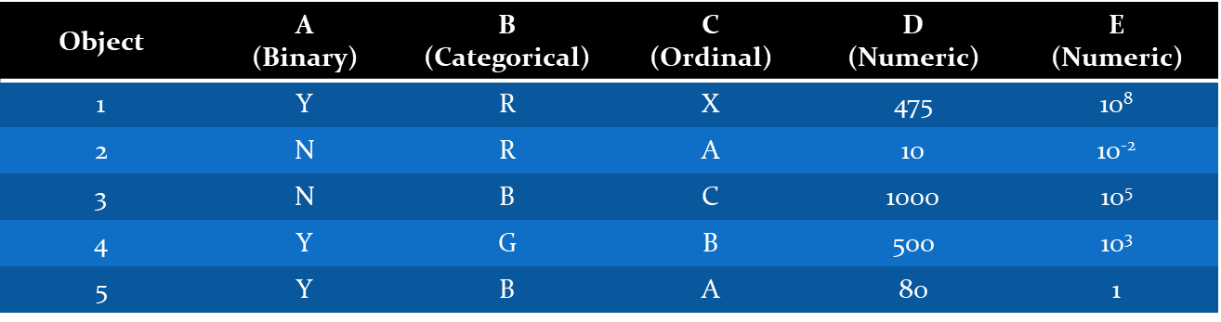
Proximity Measure with Mixed Attributes
Consider the following set of objects.

Slide 13
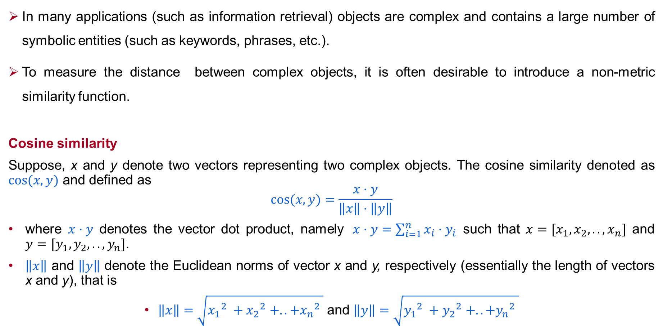
Non-Metric Similarity
In many applications (such as information retrieval) objects are complex and contains a large number of symbolic entities (such as keywords, phrases, etc.).
To measure the distance between complex objects, it is often desirable to introduce a non-metric similarity function.
Cosine similarity
Suppose, x and y denote two vectors representing two complex objects. The cosine similarity denoted as $cos⁡(x,y)$ and defined as
$$cos⁡(x,y)=\frac{x⋅y}{\left\|x\right\|⋅\left\|y\right\|}$$
where $x⋅y$ denotes the vector dot product, namely$x⋅y=\sum_{i=1}^{n}{x_{i}⋅y_{i}}$ such that $x=[x_{1},x_{2},..,x_{n}]$ and $y=[y_{1},y_{2},..,y_{n}]$.
$\left\|x\right\|$ and $\left\|y\right\|$ denote the Euclidean norms of vector x and y, respectively (essentially the length of vectors x and y), that is
$\left\|x\right\|=\sqrt{{x_{1}}_{}^{2}+{x_{2}}_{}^{2}+..+{x_{n}}_{}^{2}}$ and $\left\|y\right\|=\sqrt{{y_{1}}_{}^{2}+{y_{2}}_{}^{2}+..+{y_{n}}_{}^{2}}$

Slide 14
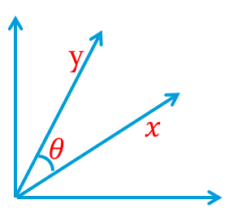
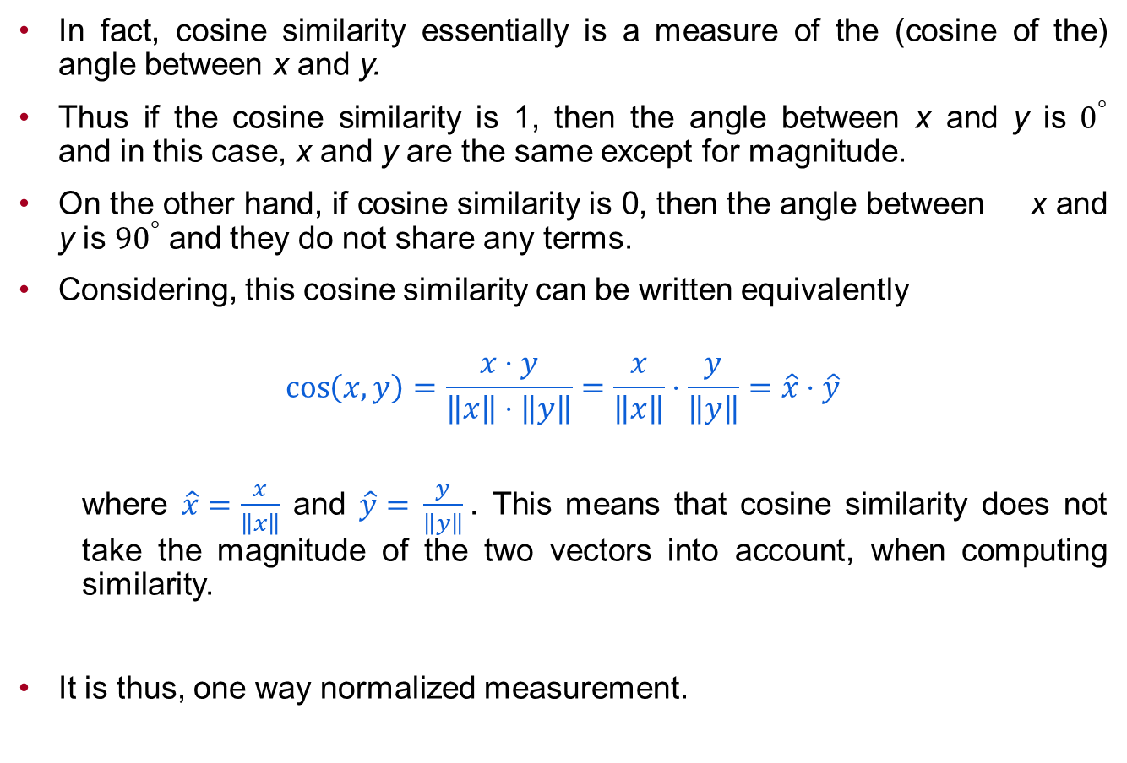
Cosine Similarity
In fact, cosine similarity essentially is a measure of the (cosine of the) angle between x and y.
Thus if the cosine similarity is 1, then the angle between x and y is $0^{°}$ and in this case, x and y are the same except for magnitude.
On the other hand, if cosine similarity is 0, then the angle between x and y is ${90}^{°}$ and they do not share any terms.
Considering, this cosine similarity can be written equivalently
$$\cos\left(x,y\right)=\frac{x⋅y}{\left\|x\right\|⋅\left\|y\right\|}=\frac{x}{\left\|x\right\|}⋅\frac{y}{\left\|y\right\|}=\hat{x}⋅\hat{y}$$
where $\hat{x}=\frac{x}{\left\|x\right\|}$ and $\hat{y}=$ $\frac{y}{\left\|y\right\|}$. This means that cosine similarity does not take the magnitude of the two vectors into account, when computing similarity.
It is thus, one way normalized measurement.

Slide 15
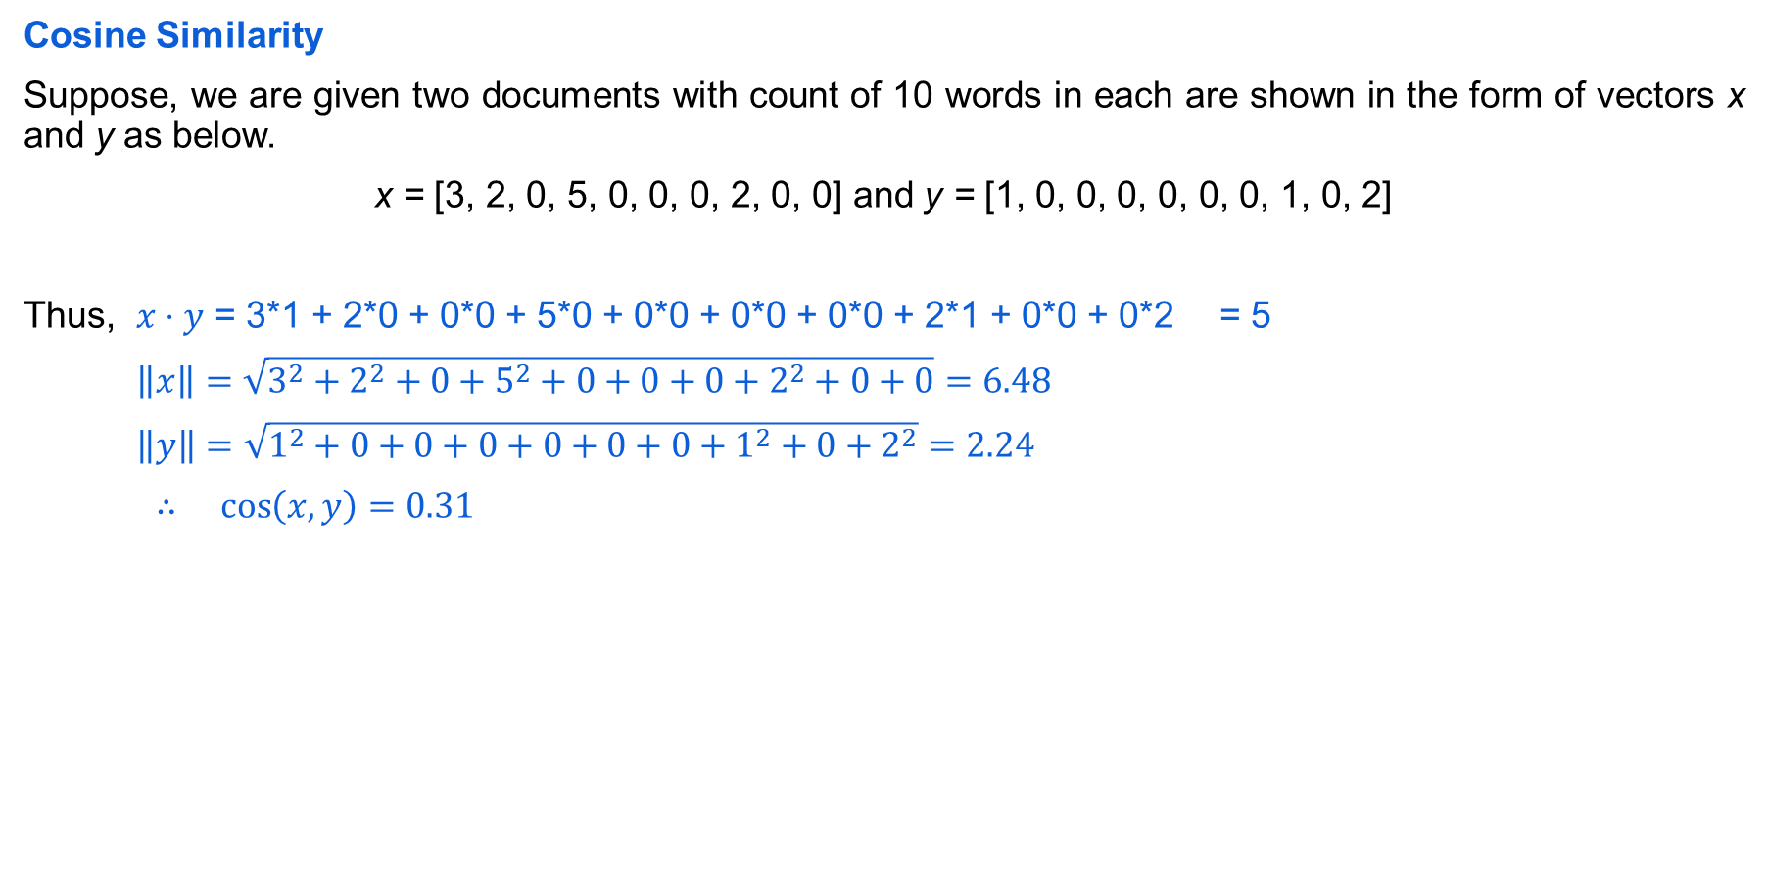
Non-Metric Similarity
Cosine Similarity
Suppose, we are given two documents with count of 10 words in each are shown in the form of vectors x and y as below.
x = [3, 2, 0, 5, 0, 0, 0, 2, 0, 0] and y = [1, 0, 0, 0, 0, 0, 0, 1, 0, 2]
Thus, $x⋅y$ = 3*1 + 2*0 + 0*0 + 5*0 + 0*0 + 0*0 + 0*0 + 2*1 + 0*0 + 0*2 = 5
$\left\|x\right\|=\sqrt{3^{2}+2^{2}+0+5^{2}+0+0+0+2^{2}+0+0}=6.48$
$\left\|y\right\|=\sqrt{1^{2}+0+0+0+0+0+0+1^{2}+0+2^{2}}=2.24$
$∴\cos\left(x,y\right)=0.31$

Slide 16
Thank You!
In our next session: Curse of Dimensionality

